Slide 1
CoCo Conference
peer reviewed conferences powered using cloud technology

Slide 2
Agenda
What is CoCo Conference
Technologies Used
Node.JS
Heroku
Amazon Dynamo
Plotly
Advantages of Cloud Technology
Disadvantages of Cloud Technology
Demo
Questions

Slide 3
What is CoCo Conference
A Peer review platform
Focusing on academic conferences
Create, comment, and share your conference experience
Tell others how great the conference was
Tell others about your general experience while attending
Conference Analytics
Overall averages
User analysis

Slide 4
Why Conferences?
Academic conferences are notoriously expensive to attend
Attendees usually pick and choose what conferences they attend in a year
Some conferences are hosted poorly
Some conferences lack academic substance
There is a lack of conference listings to indicate the quality of these conferences

Slide 5
Technologies used
Node.JS
Heroku Web Services
Amazon Dynamo
Plotly

Slide 6

Node.JS
The project’s framework
JavaScript runtime built on Chrome's V8 JavaScript engine
Event-driven, non-blocking I/O model
lightweight and efficient
Package management system npm
Large ecosystem of open source libraries

Slide 7

Heroku
Project’s hosting service
GitHub integration
Scales easily, both vertically and horizontally

Slide 8
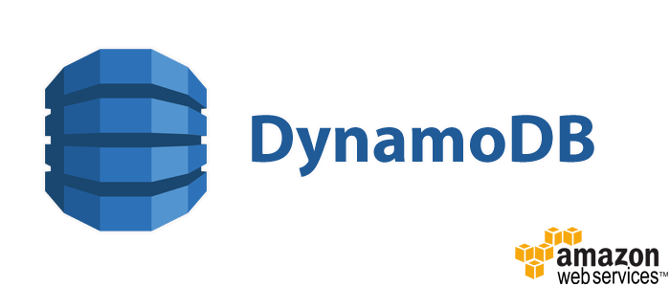
Amazon Dynamo
Used as the database
NoSQL cloud based solution
Little latency between requests
supports both document and key-value store models

Slide 9

Plotly Analytics
Used to create the graphs and analytics used in the project
Compatible with a range of tools
Python
R
MATLAB
Javascript
An API that creates graphs and analytics

Slide 10
Advantages of Cloud Technology

Slide 11
Disadvantages of Cloud Technology

Slide 12
Demo

Slide 13
Questions and Answers

